Slide 1
The Use of Radar-Based Techniques to Warn for Tornadoes in the Albany Warning Area
Hailey Culwell
Mentor: Michael Evans and Christina Speciale

Slide 2
Background
The National Weather Service has been aiming to create a way to increase effectiveness of tornado warnings
The organization has collaboratively been researching methods for decreasing the amount of false alarms and increasing the probability of detecting tornadoes
This is the Tornado Warning Improvement Project (TWIP)

Slide 3
Background
Boston NWS researched ways to improve tornado forecasting in their warning area
Focus on synoptic and mesoscale environment and radar data of tornado cases from 2007 to 2017
Put together a point system warning strategy

Slide 4
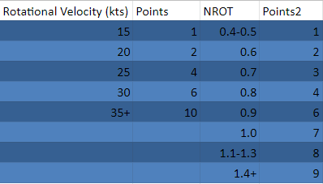
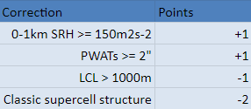
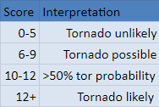
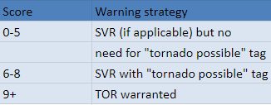
Boston’s Point System Warning Strategy

Slide 5
Goals of My Project
Northeast US generally sees few tornadoes, but the 2020 year produced more than usual
Testing of radar-based warning techniques, including Boston’s warning strategy
Implementation of more accurate and more timely tornado warnings

Slide 6
Methods
14 tornadic and 14 nontornadic cases in 2020
Examined mesoscale environment and rotational radar data for each case and classified each storm mode
Applied Boston’s warning strategy
Applied radar techniques demonstrated by the Tornado Warning Improvement Project for QLCS’s and supercells at touchdown, 10 minutes prior, and 20 minutes prior

Slide 7
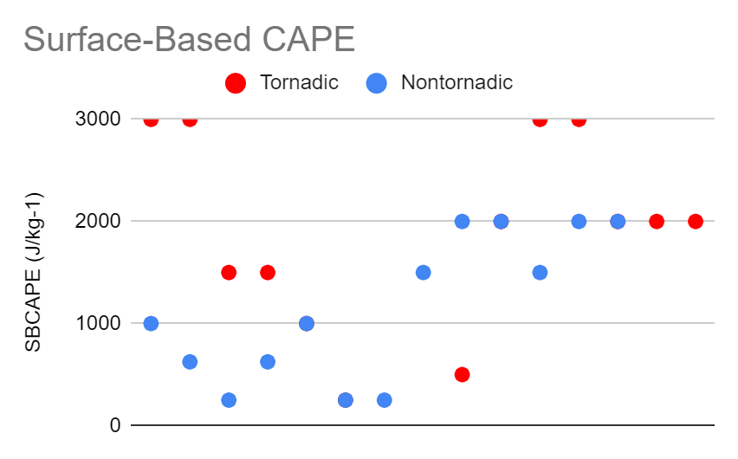
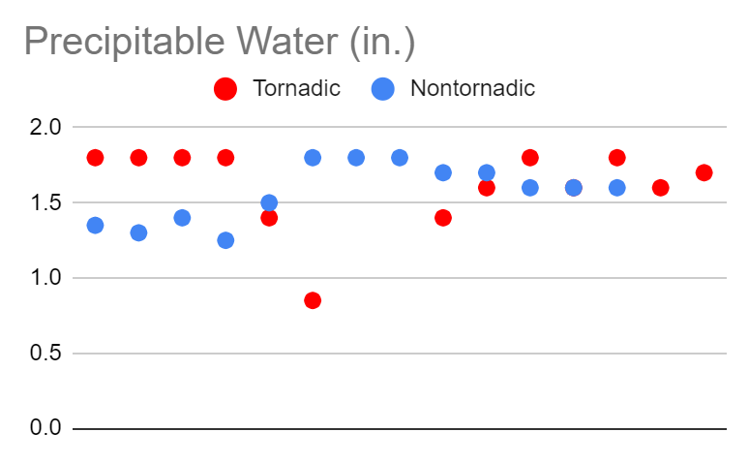
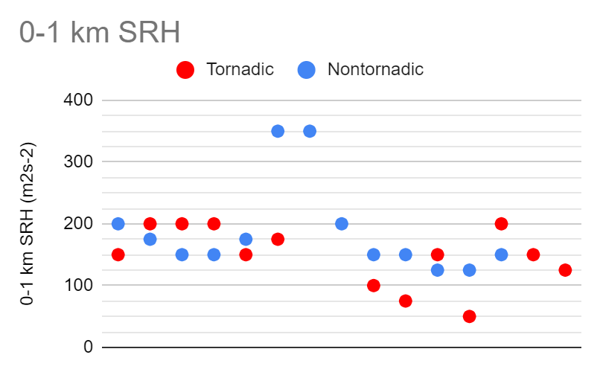
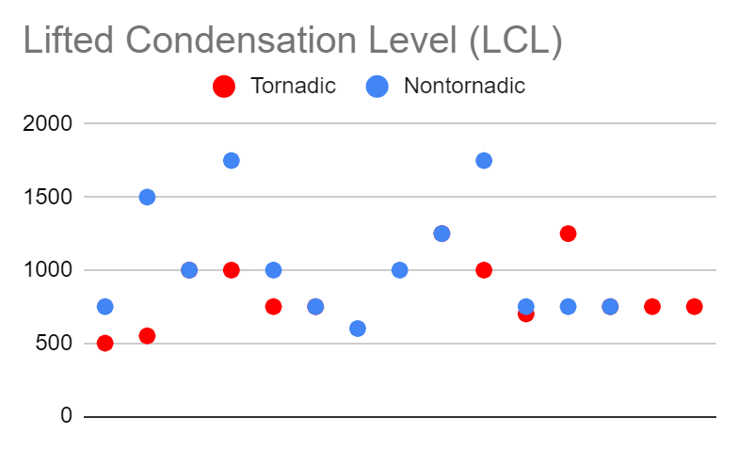
Results - Environment
Overall, the environmental data between nontornadic and tornadic cases proved to be mixed

Slide 8
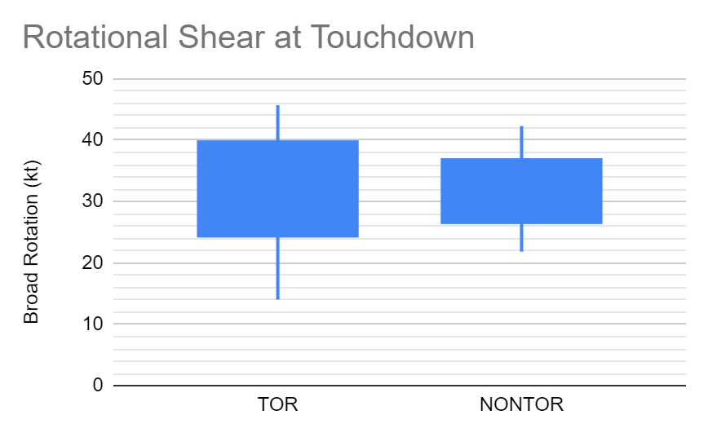
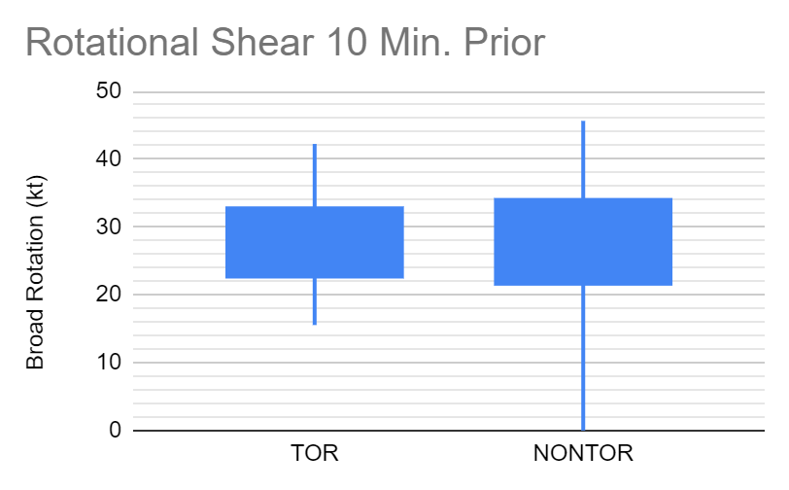
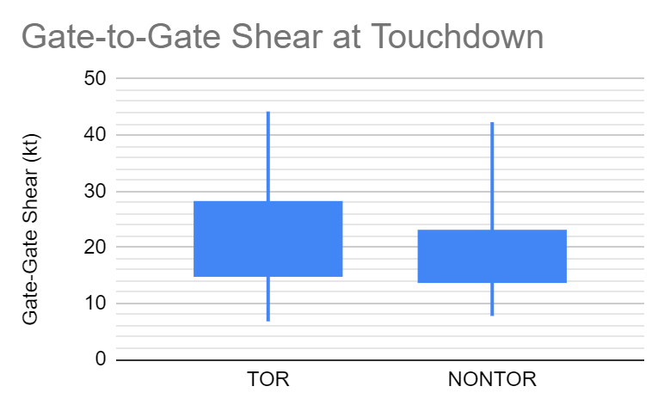
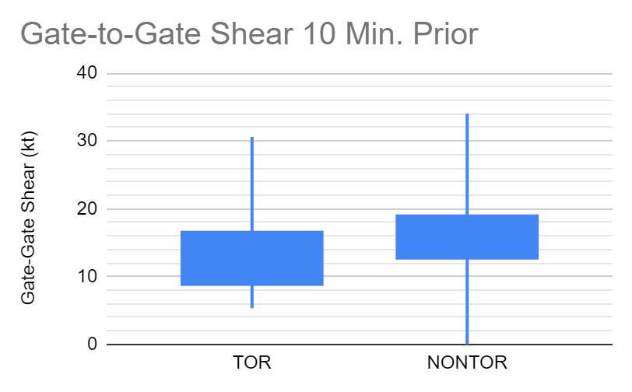
Results - Rotation

Slide 9
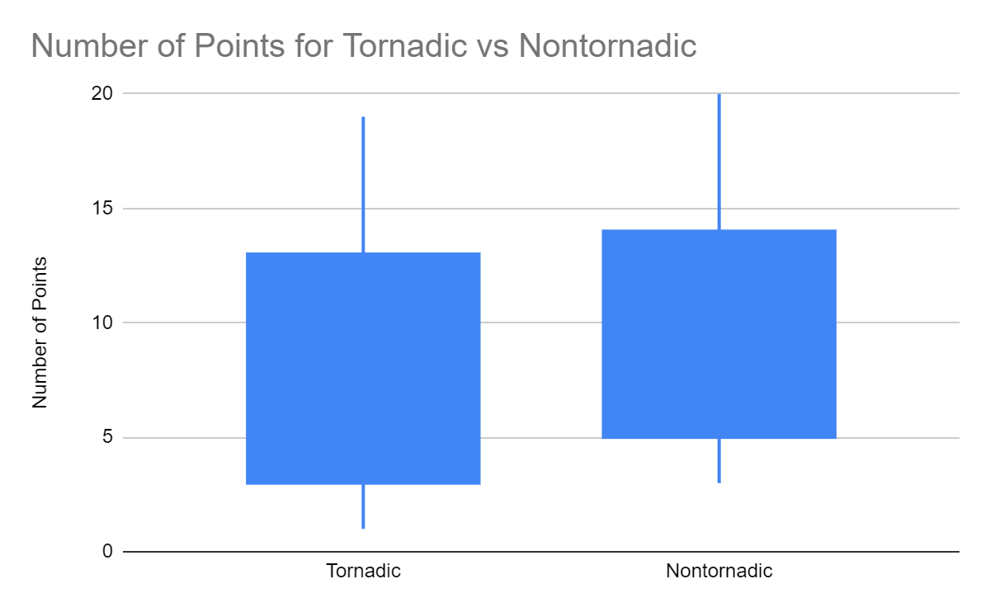
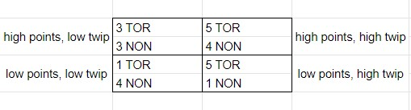
Results - Boston Warning Strategy
The points gathered exhibit little discrepancy between TOR/NONTOR (see fig.)
Tornadic Cases
9/14 scored possible or above
5/14 scored unlikely
  TWIP data supported tornadogenesis
Nontornadic Cases
9/14 scored possible or above
  4 supported no tornadogenesis with TWIP
5/14 scored unlikely

Slide 10
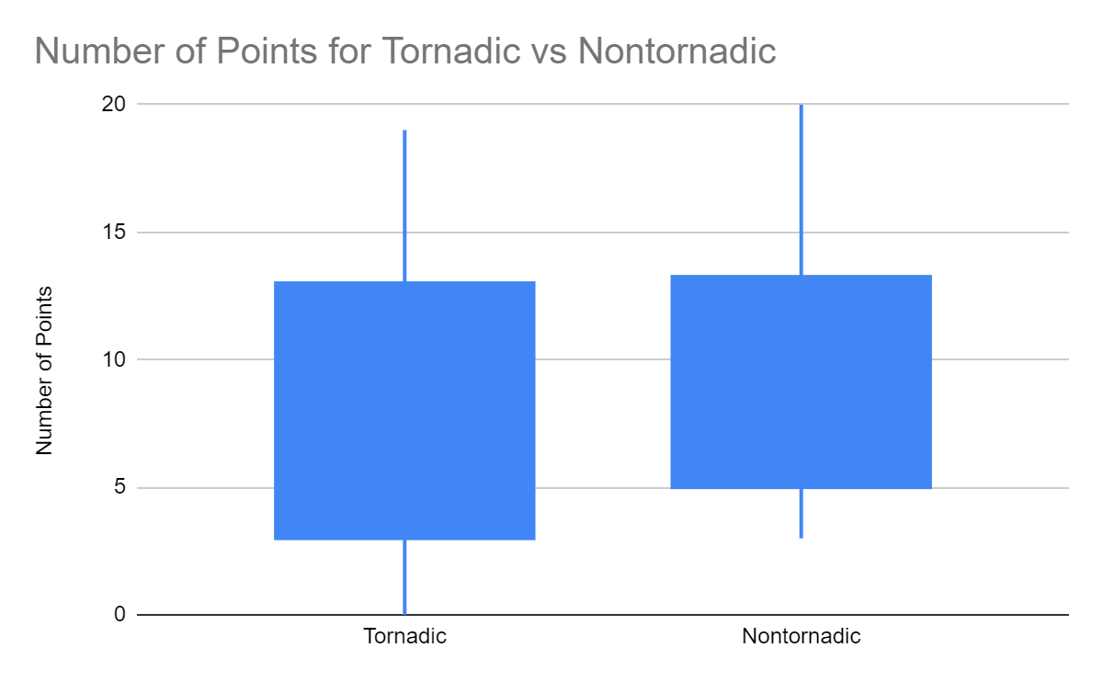
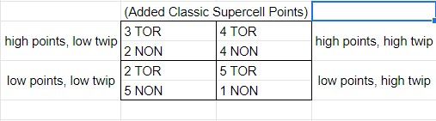
Results - Boston Warning Strategy, Cont.
These are the results when the -2 classic supercell structure points were added
Tornadic Cases
9/14 scored possible or above
5/14 scored unlikely
  TWIP data supported tornadogenesis
Nontornadic Cases
9/14 scored possible or above
  4 supported no tornadogenesis with TWIP
5/14 scored unlikely

Slide 11
Tornado Warning Improvement Project - QLCS
  Implementation of the Three Ingredients Method, followed up by the 10 confidence builders and 4 nudgers

Slide 12
TWIP - QLCS, Cont.
Confidence Builders
Descending RIJ/reflectivity drop
Enhancing surge/bow
Line break
Paired FIN/RIN
UDCZ entry point
Front reflectivity nub
Boundary ingestion
Contracting bookend vortex with VR >= 25 kt
tight/strong mesovortex with VR >= 25 kt
Confirmed tornado/TDS
Nudgers
Reflectivity tag intersecting surge/bow
0-3km MLCAPE >=40 J/kg
Cell merger/refl. Spike near surge/bow
History of tornadoes/TDS’s
Three Ingredients Method
System cold pool and ambient low level shear are balanced or slightly shear-dominant
0-3 km line-normal bulk shear magnitude is >= 30 kt
Rear inflow jet or enhanced outflow causes a surge or bow within a QLCS

Slide 13
Results - TWIP QLCS Signatures
7 QLCS cases - 3 tornadic, 4 nontornadic
Tornadic:
  2 exhibited the three ingredients at all three times examined
Nontornadic:
  Only 2 did not have all three ingredients for all times

Slide 14
Tornado Warning Improvement Project - Supercells
  Examination of the presence of a ZDR arc and a KDP foot for a qualitative assessment of the storm relative helicity

Slide 15
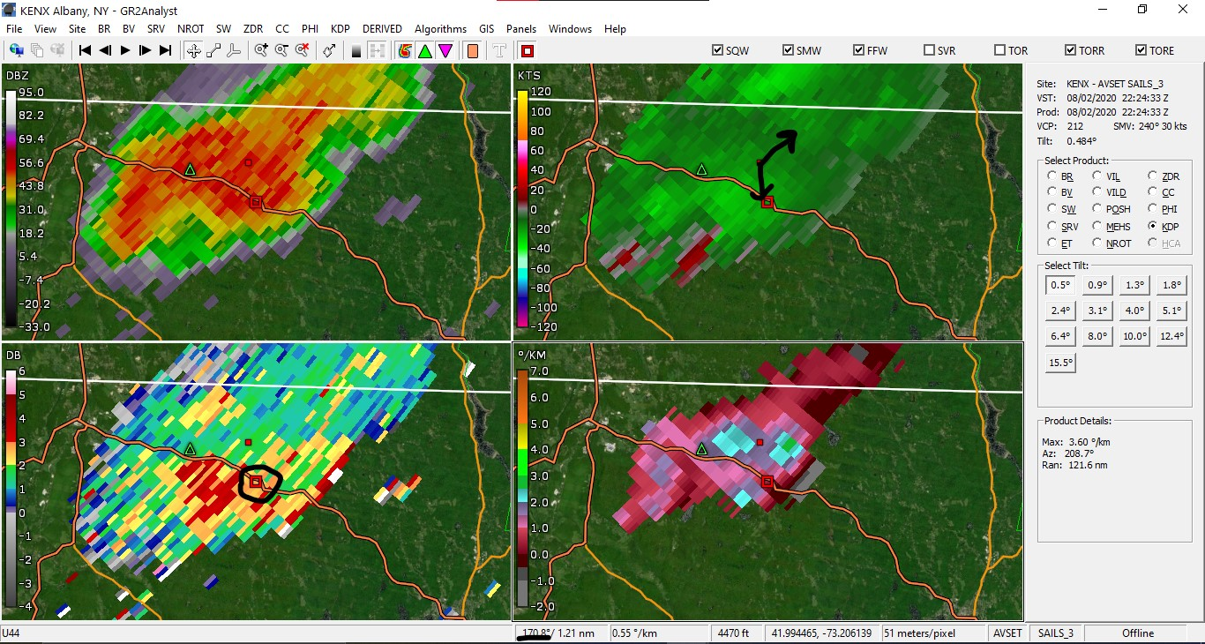
TWIP- Supercell, Cont.
Connect centroid of ZDR arc (bottom left) and KDP foot (bottom right) - separation vector
Angle between storm motion and separation vector can estimate SRH
90 deg = streamwise vorticity (high SRH)
0 deg = crosswise vorticity (low SRH)
Essentially: 45-135 deg. = moderate to high SRH - ideal for tornadogenesis
Small red square marks approximate KDP foot centroid. Open red square marks approximate ZDR arc centroid.

Slide 16
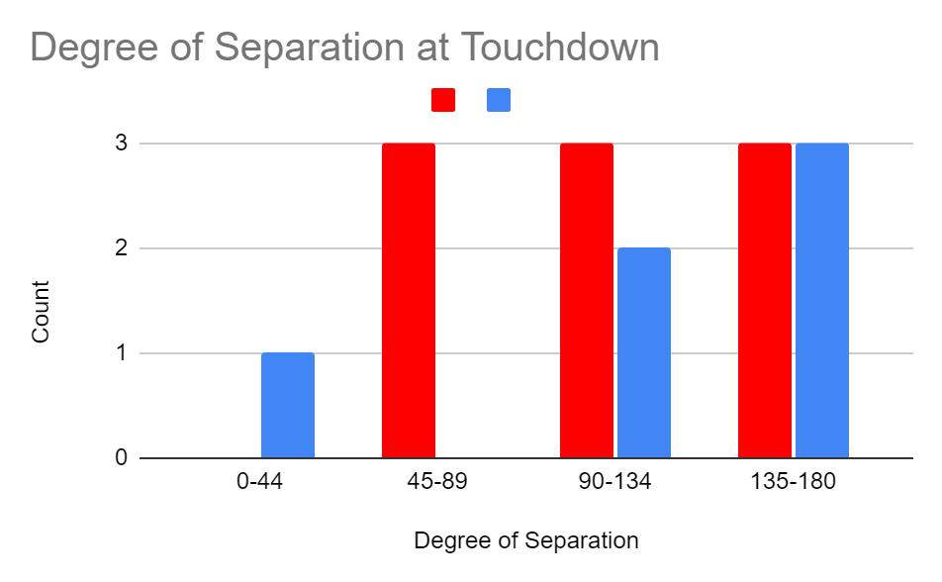
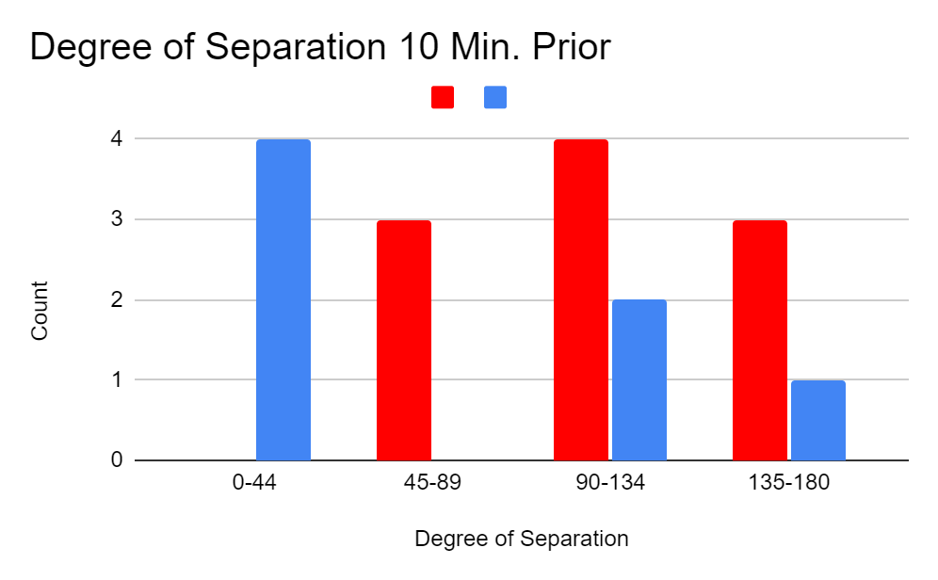
Results - TWIP Supercell Signatures
For all three times, TOR cases showed a majority over NONTOR cases in ideal range of 45-135 degrees.
Overall inconclusive as TOR cases are still present outside of the ideal range - false alarms still possible
Legend: tornadic cases are red and nontornadic cases are blue

Slide 17
Conclusions
Boston’s warning strategy proved accurate during tornadic events, but exhibited a high false alarm rate.
The TWIP supercell and QLCS signatures significantly improved warning confidence in the tornadic cases, but yet again proved unsuccessful for the nontornadic cases.
The TWIP radar signature theories overall exhibited variable accuracy in tornadic events, but are prone to false alarms.

